Slide 1
DIFFERENT TYPE OF CABLE NETWORK

Slide 2
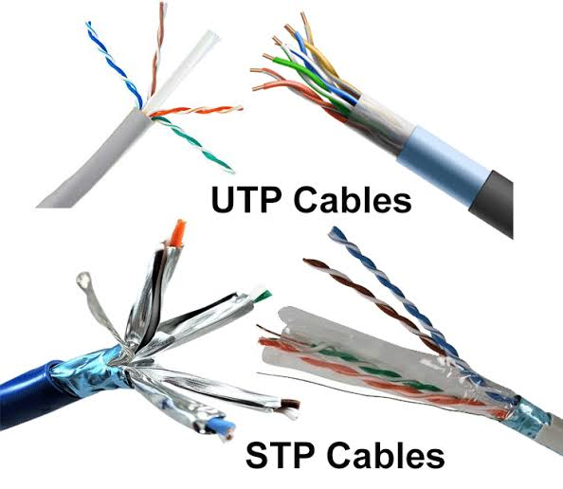
WHAT ARE THE DIFFERENT TYPES OF CABLE NETWORK ?
:- Network cables can be divided into four types: coaxial, shielded twisted pair (STP), unshielded twisted pair (UTP), or fibre optic.

Slide 3
WHAT IS CALLED NETWORK?
:- What Does Network Mean? A network, in computing, is a group of two or more devices or nodes that can communicate. The devices or nodes in question can be connected by physical or wireless connections. The key is that there are at least two separate components, and they are connected.

Slide 4
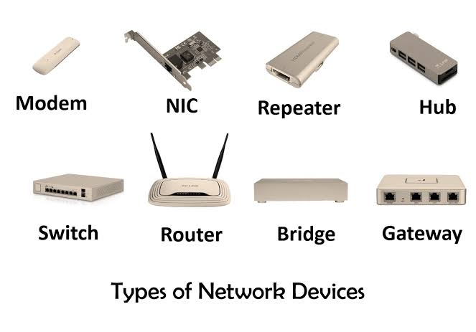
WHAT IS THE NETWORK DEVICE?
:- A network device is a node in the wireless mesh network. It can transmit and receive wireless HART data and perform the basic functions necessary to support network formation and maintenance. Network devices include field devices, router devices, gateway devices, and mesh hand-held devices. (a) Field devices.

Slide 5
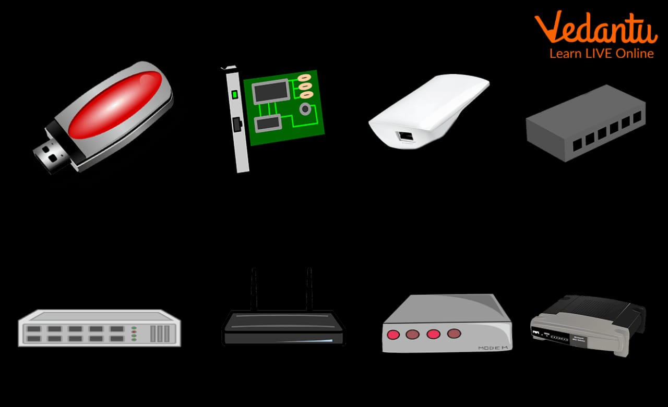
WHAT ARE THE 4 DEVICE NEEDED CONNECT TO THE INTERNET ?
:- Telephone, modem, computer and ISP are needed to connect to the network. The Computer is essential. The Modem is necessary if you are using a telephone line to access the Internet.

Slide 6
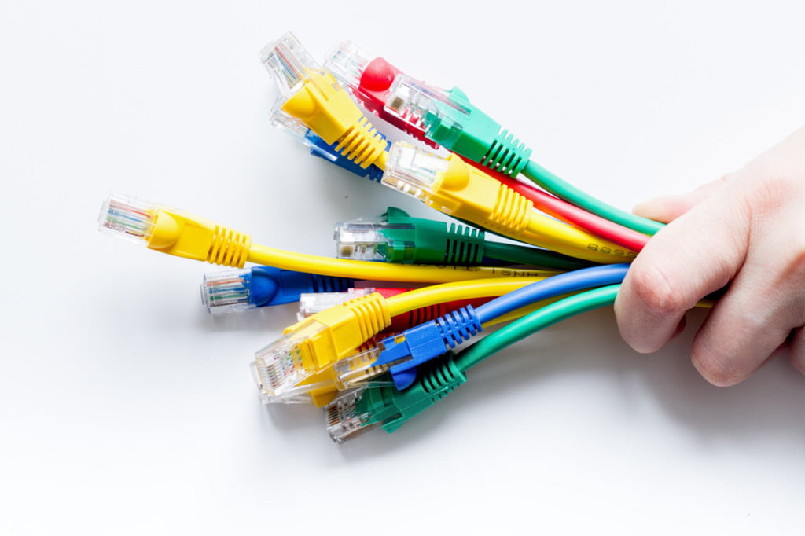
WHICH CABLE IS BEST FOR NETWORKING?
:- Which Ethernet cable is best? This depends on your needs, but for most home users, Cat 6 will be more than sufficient for high-speed networking, fast internet connectivity, and low-latency tasks like gaming. If you want greater performance over longer distances — over 150ft — then Cat 6a is worth

Slide 7
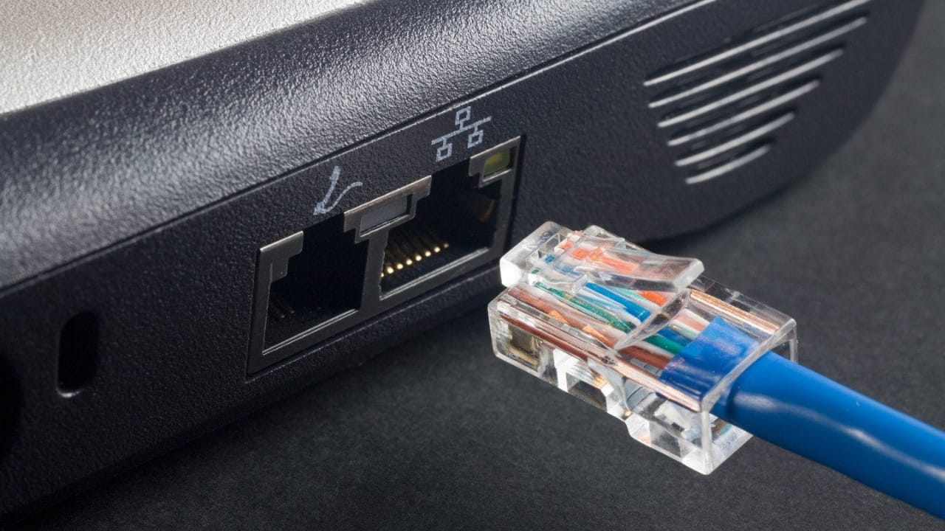
WHAT IS THE FASTEST NETWORK CABLE?
:- Cat 8 – the fastest cable Cat 8 is the highest-performing Ethernet cord available. It is the recognized standard “after Cat 6, having faster throughput over short distances: 40 Gbps up to 78’ and 25 Gbps up to 100’,” accordingly to telco-data.com. Its bandwidth goes to

